Slide 1

PROCESS SAFETY EXCELLENCE

Slide 2
HOW WILL PSM EXCELLENCE IN INDIA LOOK LIKE?
NEW SAFETY & OPERATIONAL RISKS THAT OCCUR BETWEEN ANNUAL ENDORSEMENT.
RISKS THAT ARE NEWLY IDENTIFIED OR HAVE MATERIALLY INCREASED NEED A HIGHER LEVEL OF FOCUS AND CONTROLS.
ANY NEW INFORMATION THAT MAY HAVE MATERIAL IMPACT ON EXISTING S&OR RISKS (RISK REGISTER).
IS COMPLEMENTARY WITH ANNUAL RISK REVIEW PROCESS

Slide 3
THE SCENARIO TODAY
2020- VISAKHAPATTNAM VIZAG INCIDENT – 20 FATALITIES
2025- SIGACHI BLAST - > 50 FATALITIES
2026 – VEDANTA BOILER EXPLOSION - > 20 FATALITIES

Slide 4
NUMEROUS INCIDENTS- COMMON CAUSES
BYPASSING CONTROLS
LACK OF RISK KNOWLEDGE & SENSITIVITY.
FOCUS ON PRODUCTION TARGETS LOSING SIGHT OF SAFETY

Slide 5
THE QUESTION
WE KEEP SAYING “SAFETY FIRST”
WHY PEOPLE BYPASS CONTROLS JEOPARDIZING SAFETY?
WHY PEOPLE IGNORE RISKS?
WHY LIFE BECOMES SECONDARY TO PRODUCTION TARGETS?

Slide 6
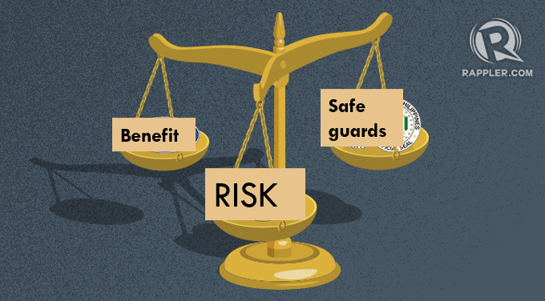
FROM SAYING TO DOING
THE DEMONSTRATION OF BALANCE = SAFETY LEADERSHIP

Slide 7
Emerging Risk Notification Form

Slide 8
THANK YOU

